Slide 1
Distributional Analysis of Housing Quality in New York City
Ahern Nelson, Yusi Li

Slide 2
Background
We analyze data from the New York City Housing and Vacancy Survey^{[1]} (NYCHVS).
Data is collected in 1991 and triennially from 1993-2017 (10 datasets in total). Each survey consists of around 10,000-15,000 randomly selected units in NYC.
Units are monitored for quality conditions and formal interviews are conducted with residents of occupied units.
Each survey consists of 126-222 columns/questions, most of them are categorical.

Slide 3
Introduction: Measuring Housing Quality
New York has an interesting housing population for study.
Nationwide trends are often incongruent:
67% or New Yorkers rent their residence (compared to 36% nationwide^{[2]}).
45% of units are rent-regulated (Most states prohibit rent-regulation^{[3]}).
Large population of dwellings constructed before 1947.
Dramatic change since 1970:
Crime has sharply decreased.
Income and quality of living have increased.
How has housing quality changed over time?

Slide 4
Approach
We wish to construct an index to quantify the quality of housing units in NYC.
In March 2013, The US Dept. of HUD published American Housing Survey: A Measure of (Poor) Housing Quality^{[4]}.
In this report, the authors detail a process for constructing such an index based on responses to the AHS. They dub this the Poor Housing Quality Index (PQI).
We follow a similar approach, using the same name, suited for our data.

Slide 5
Table 1. Poor Housing Quality Index
Item | Description | NYCHVS Variable | Score
1 | Exterior Walls: Missing brick, sliding or other | d1 | 2
2 | Exterior Walls: Sloping or bulging walls | d2 | 2
3 | Exterior walls: Major Cracks | d3 | 2
4 | Exterior Walls: Loose or hanging corvice, roof, etc. | d4 | 2
5 | Interior Walls: Cracks or holes | 36a | 2
6 | Interior Walls: Broken plaster or peeling paint | 37a | 2
7 | Broken or missing windows | e1 | 5
8 | Rotten or loose windows | e2 | 2
9 | Boarded up windows | e3 | 3
10 | Sagging or sloping floors | g1 | 2
11 | Slanted/shifted doorsills or frames | g2 | 2
12 | Deep wear in floor causing depressions | g3 | 2
13 | Holes or missing flooring | g4 | 2
14 | Stairs: Loose, broken, or missing stair | f1 | 2
15 | Stairs: Loose, broken, or missing setps | f2 | 2
16 | No interior steps or stairways | f4 | 2
17 | No exterior steps or stairways | f5 | 2
18 | Number of heating equipment breakdowns | 32b | 2 per break down
19 | Kitchen facilities fucntioning | 26c | 3 if no; 5 if no kitchen facilities
20 | Toilet Breakdowns | 25c | 3 if any; 5 if no toliet or plumbing
21 | Presence of mice or rats | 35a | 3
22 | Water Leakage | 38a | 3

Slide 6
Evaluating the Index
Example: Consider a unit with boarded up windows, two heating equipment breakdowns, and no toilet or plumbing.
PQI: 3 + 2(2) + 5 = 12
A unit with no detected issues would be 0.
PQI is an ordinal measure meaning that while a unit with a PQI of 6 is measured as worse than unit with a PQI of 3 it is not twice as bad.

Slide 8
Some Notes on PQI
The weights are subjectively chosen for each input variable, but equal weighting is the default.
Example: It is the authors’ opinion that a unit with no toilet or plumbing (marginal PQI of 5) is in worse condition than unit with holes or missing flooring (marginal PQI of 2).
Extent of issues not captured by data.
If data is not present, the index assumes a value of zero.
Most index variables are available across all years. (By design)

Slide 9
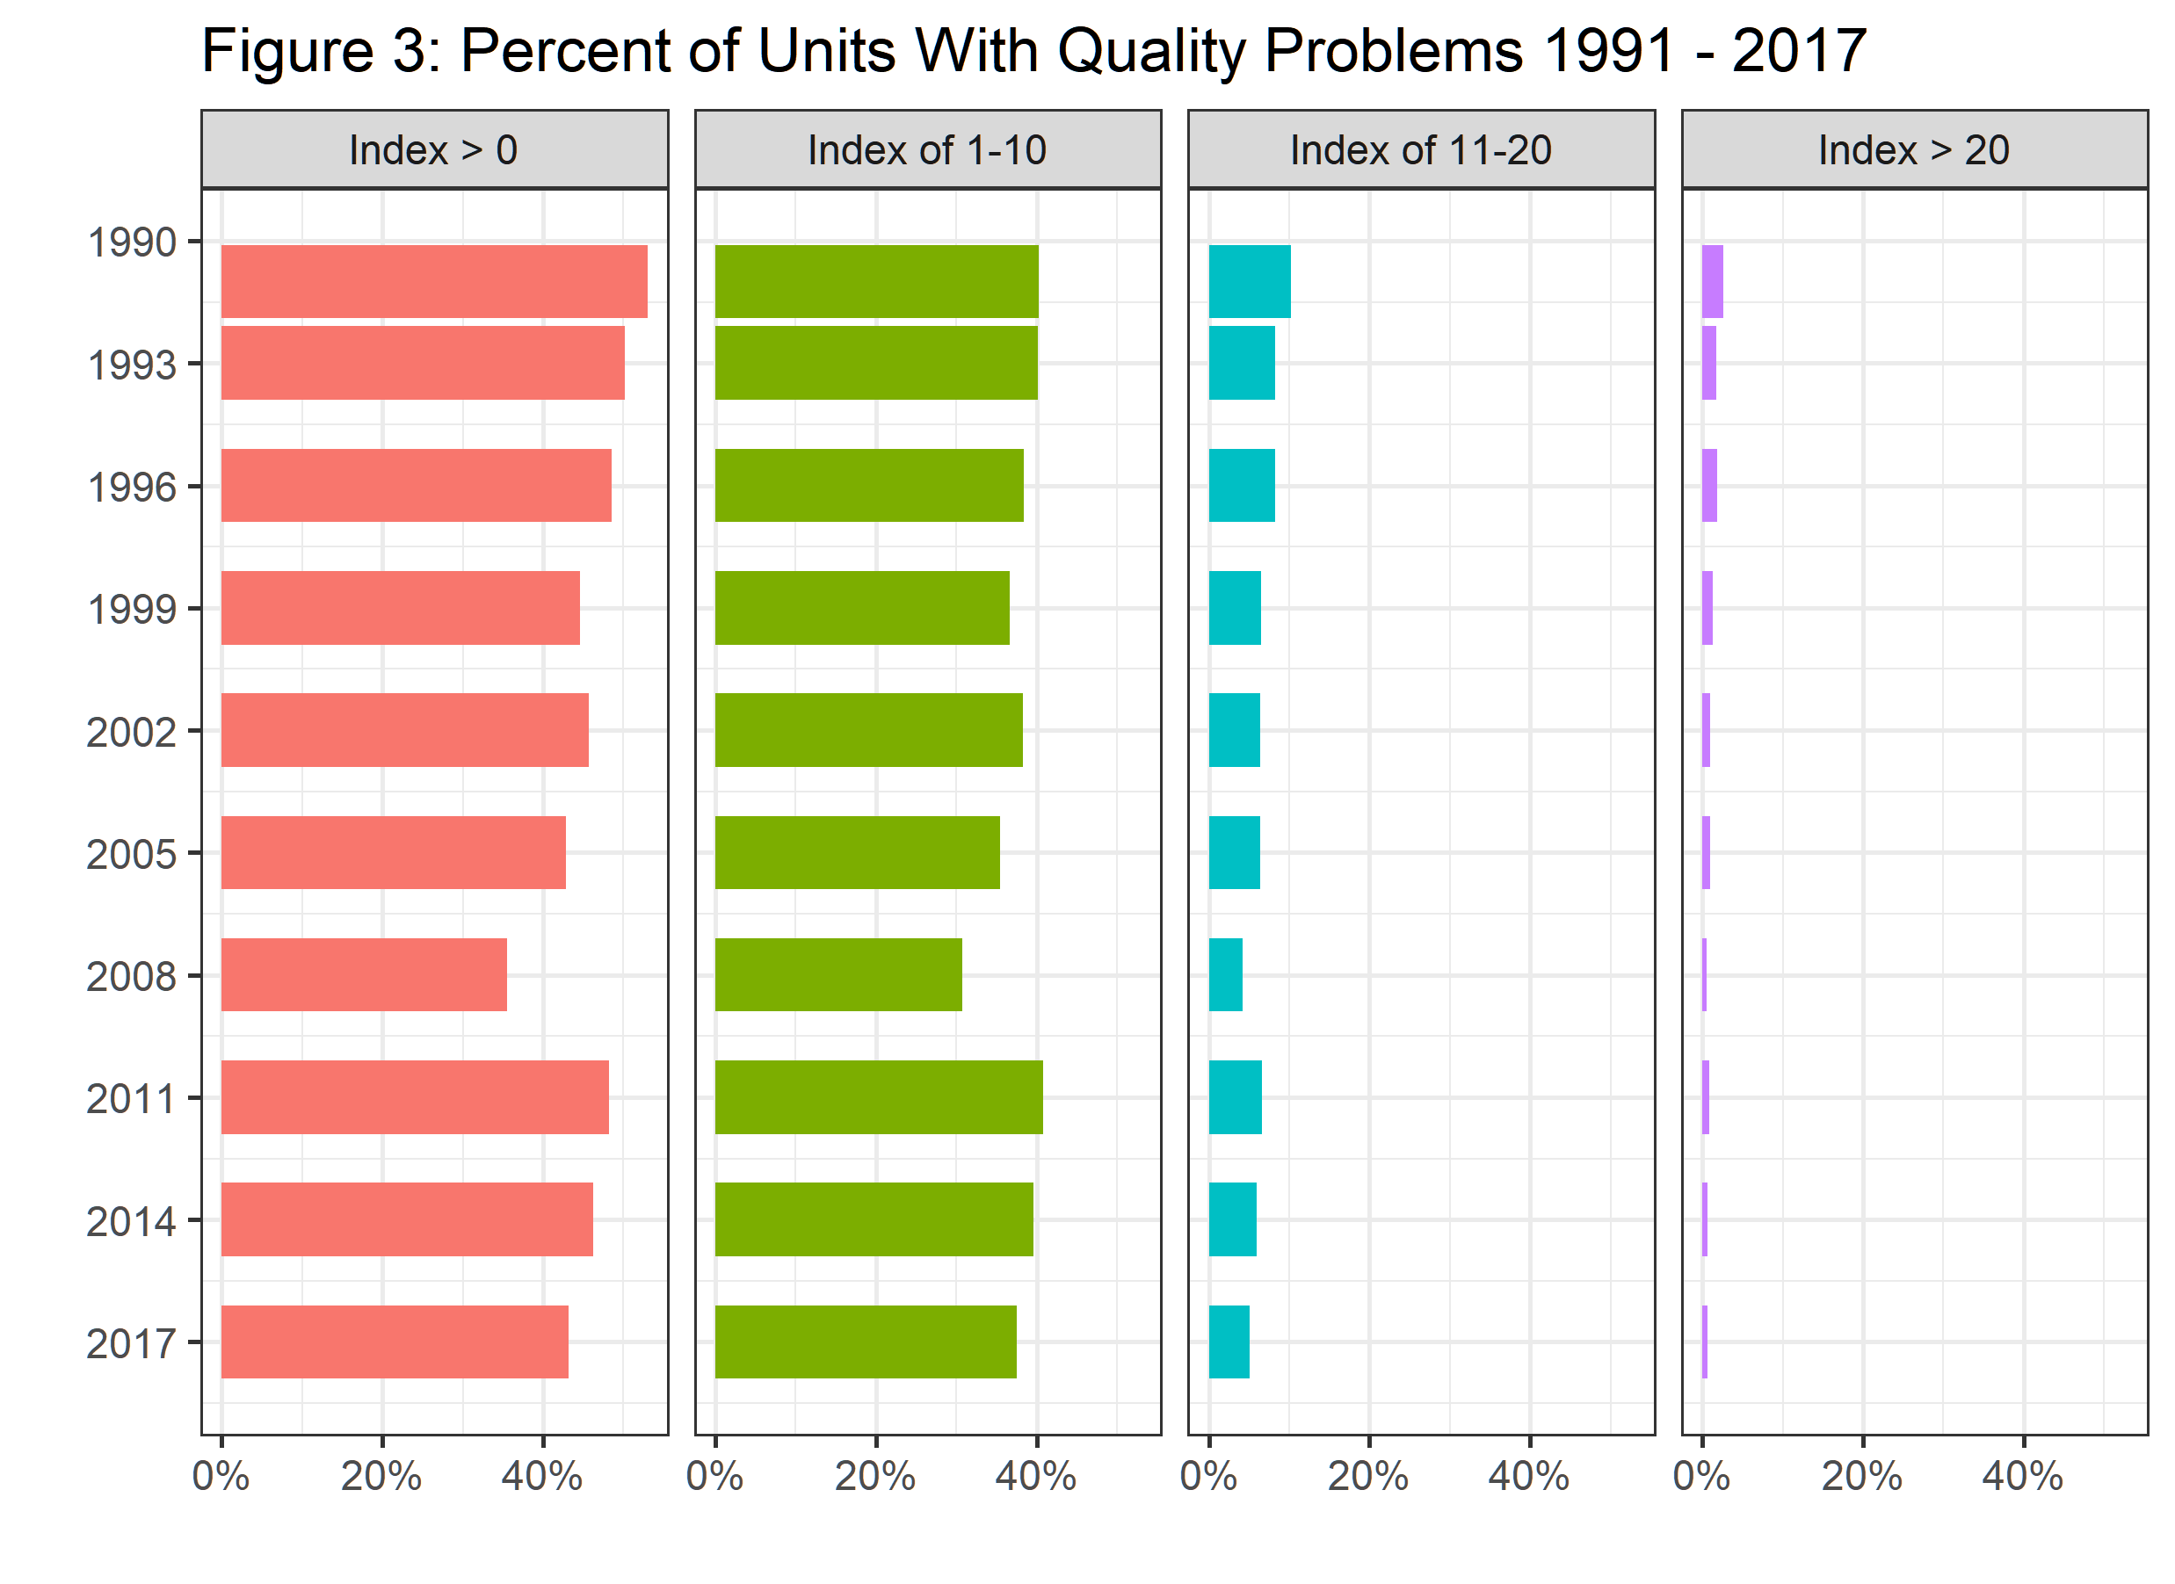

Slide 10
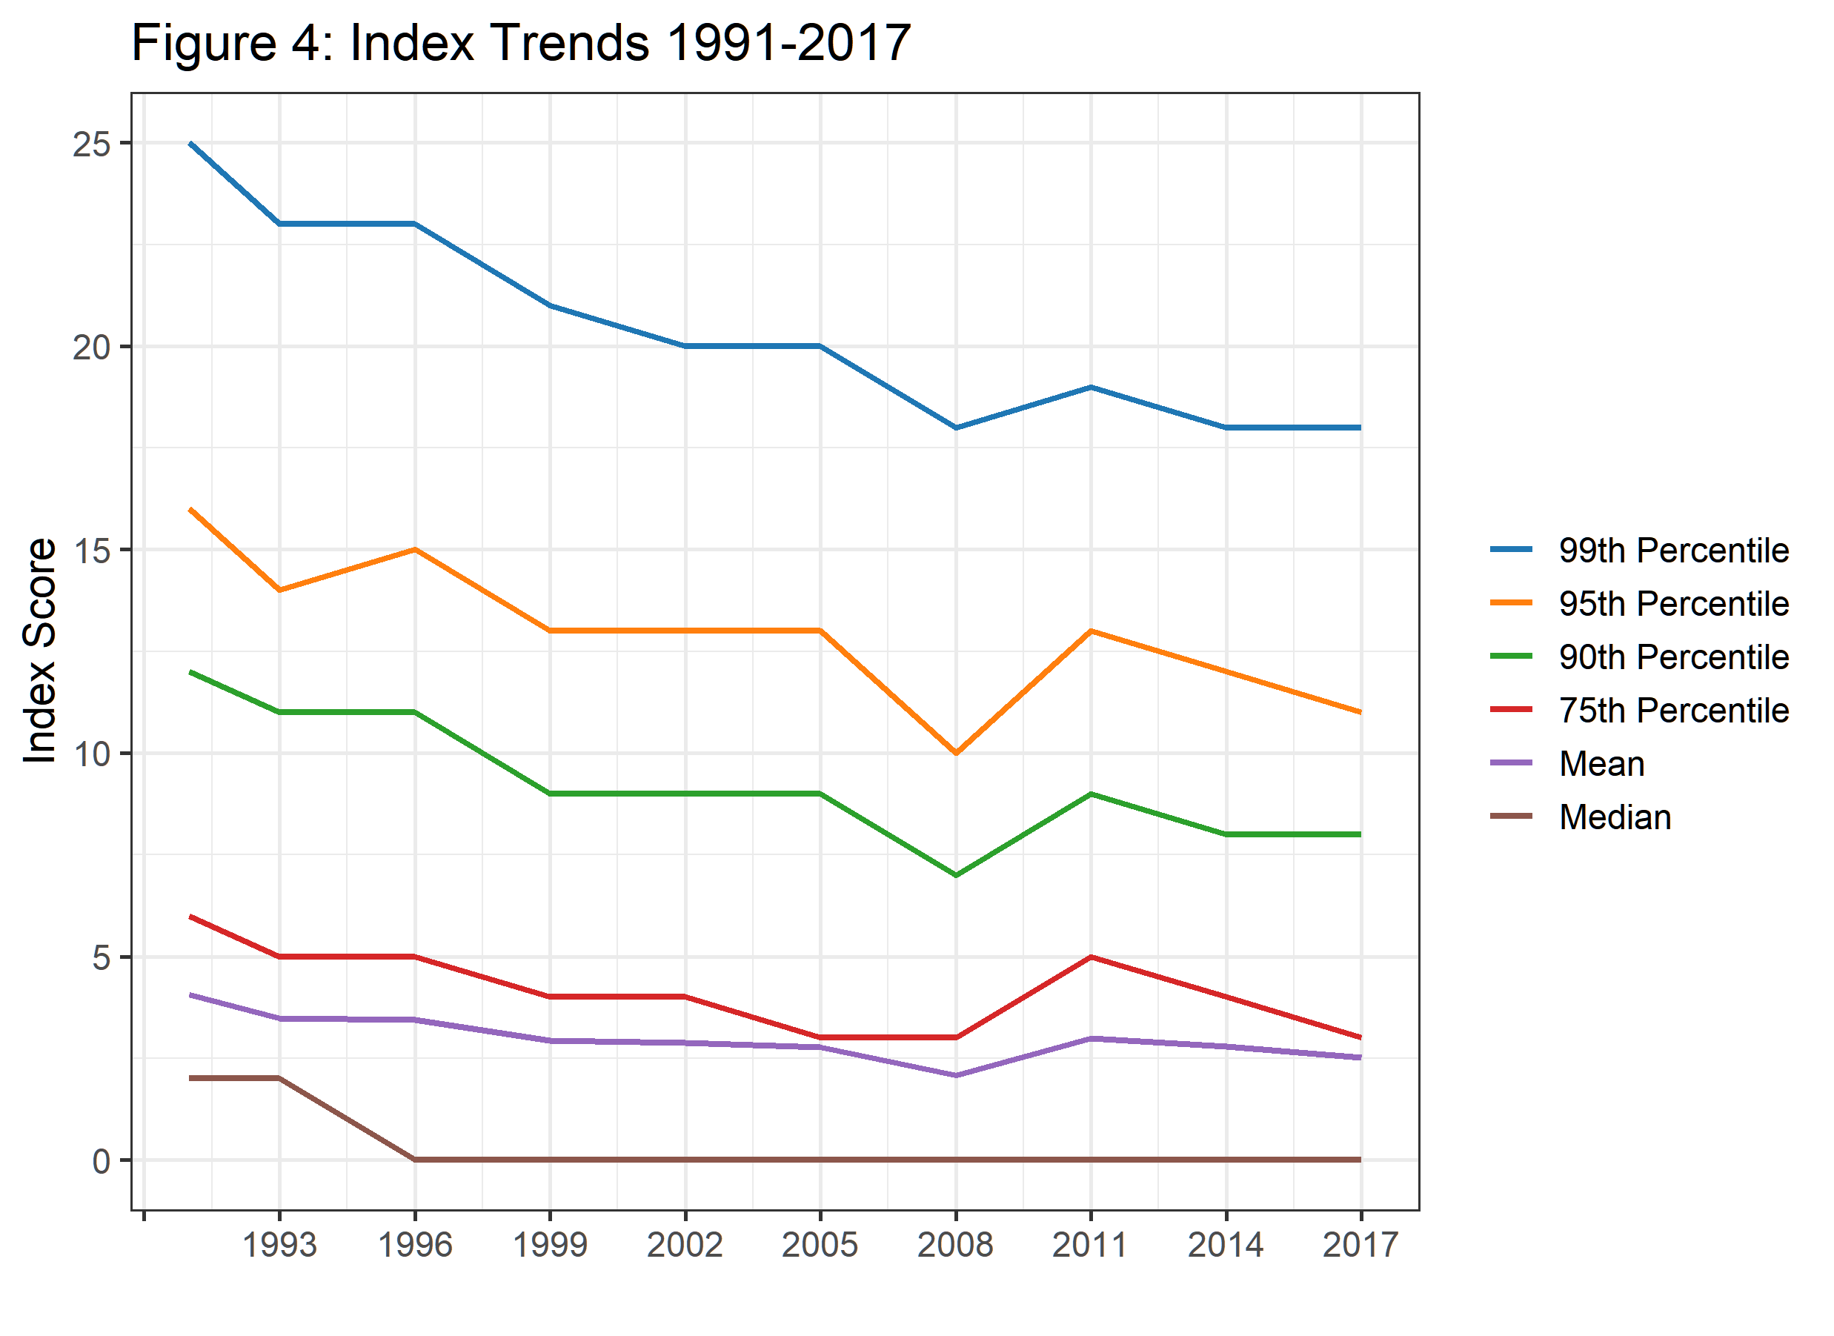

Slide 11
Preliminary Analysis of Rental Units
Gaps between subsidized, rent controlled, and owner-occupied units

Slide 12
Rental Units in NYC
We previously noted to the drop in PQI recorded in 2008.
This marks an important point in housing markets, ownership of homes was growing fast.
The crash saw many homeowners lose their property.
Question: Do rental units have a higher PQI, on average, than owner occupied units?

Slide 13
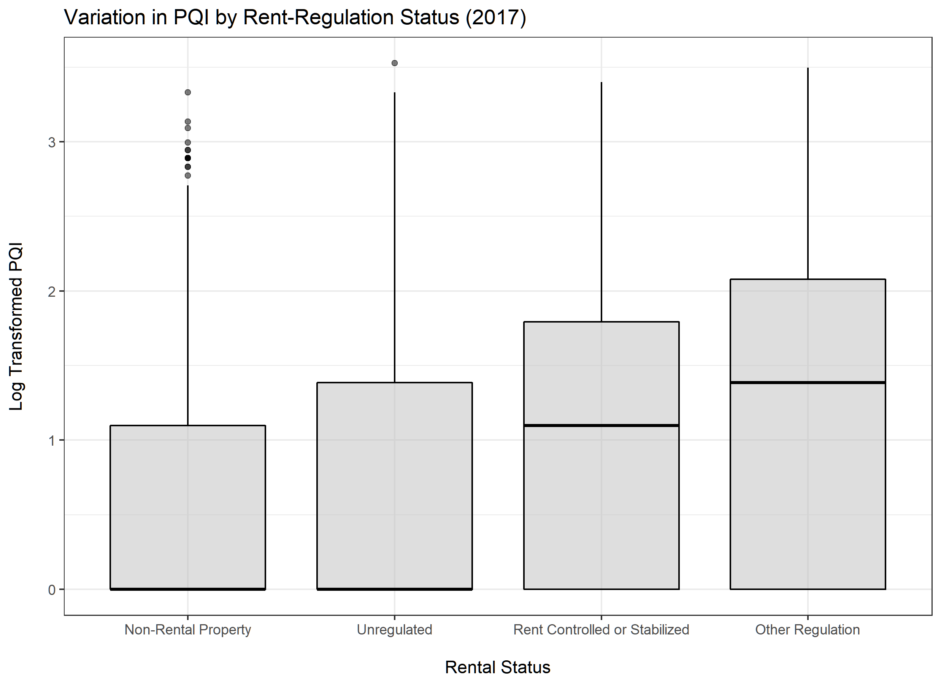

Slide 14
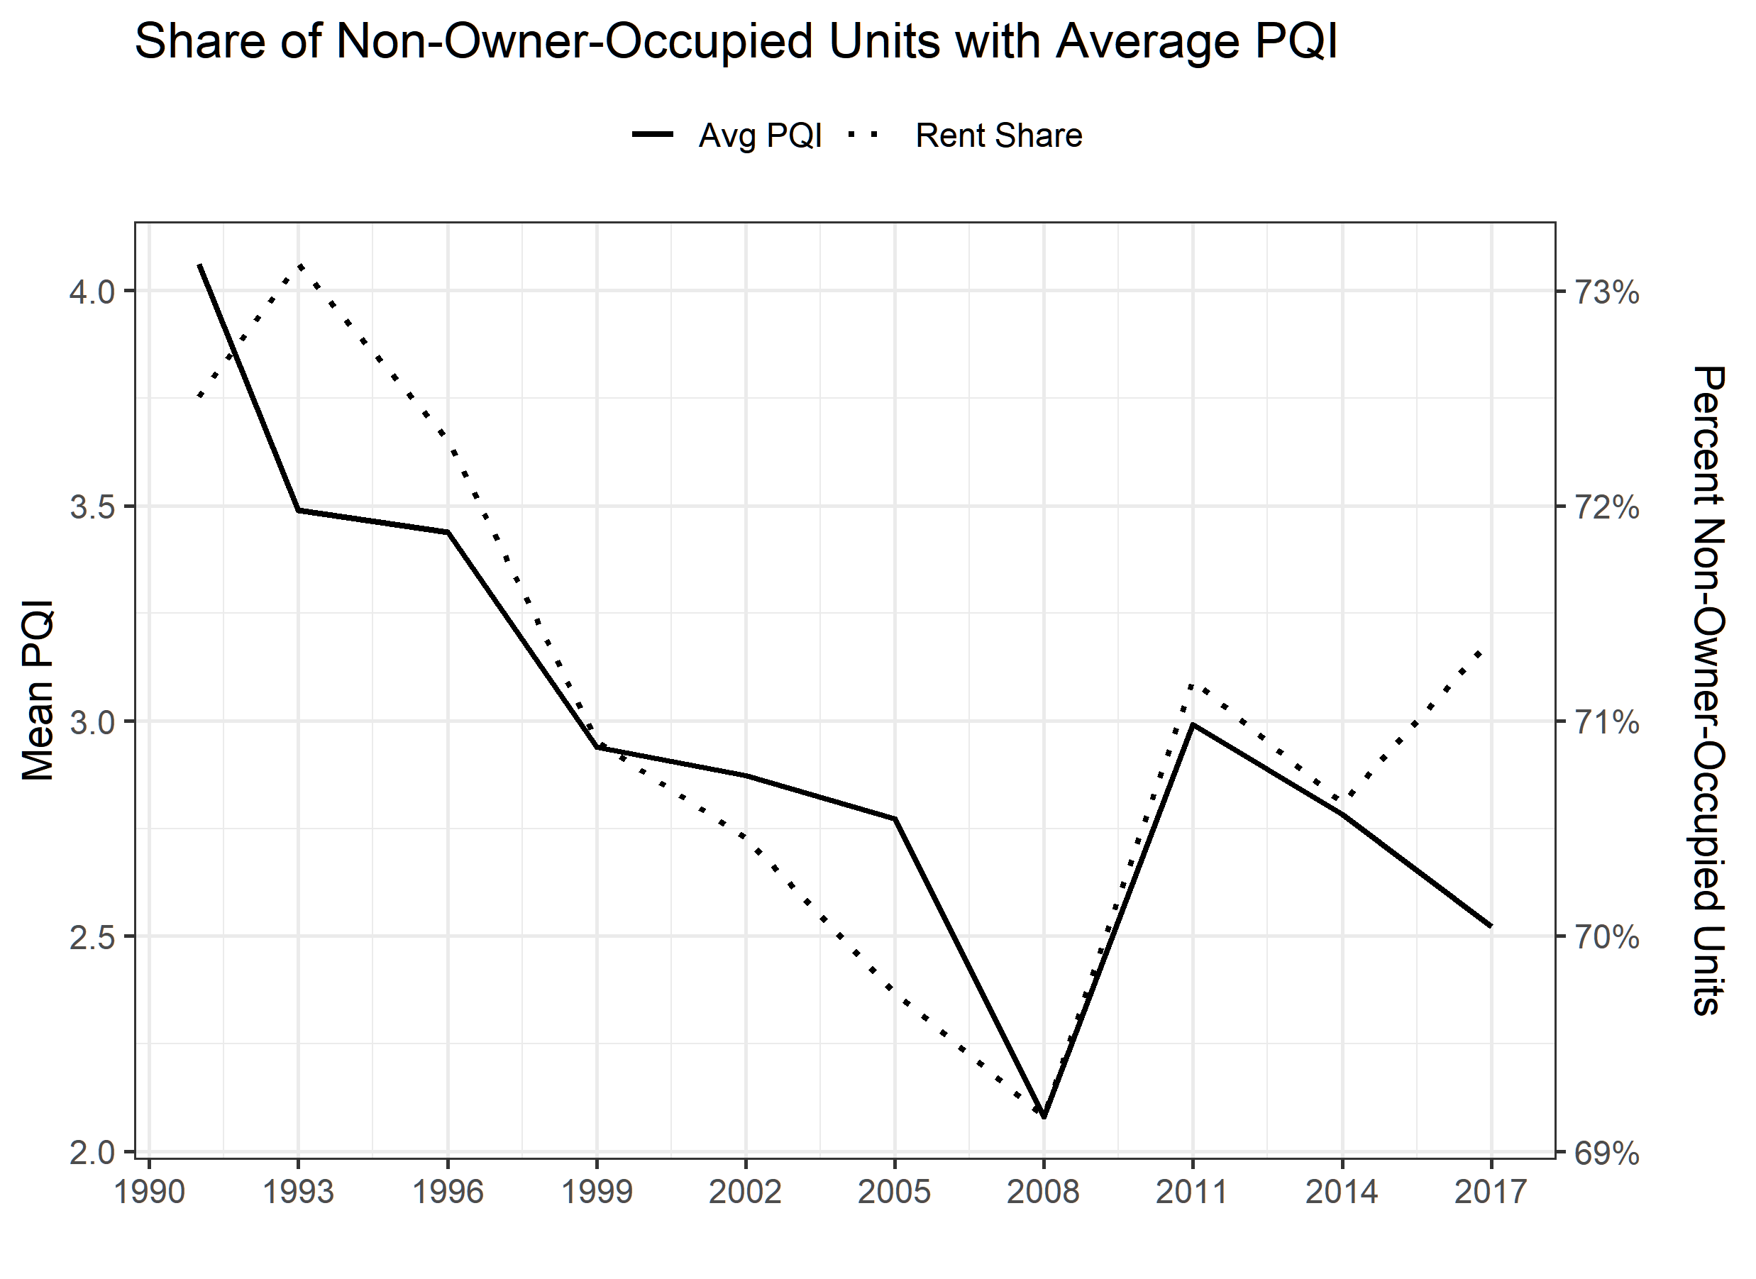

Slide 15
Household Characteristics
And Variable Selection

Slide 16
Householder’s characters
We have constructed an index PQI to quantify the quality of housing units in NYC by variables which decribe the house conditon
We will explore the variables about householder’s characters to answer the two questions:
What the relationship bewteen householder’s characters with the PQI
How these characters impact the PQI

Slide 17
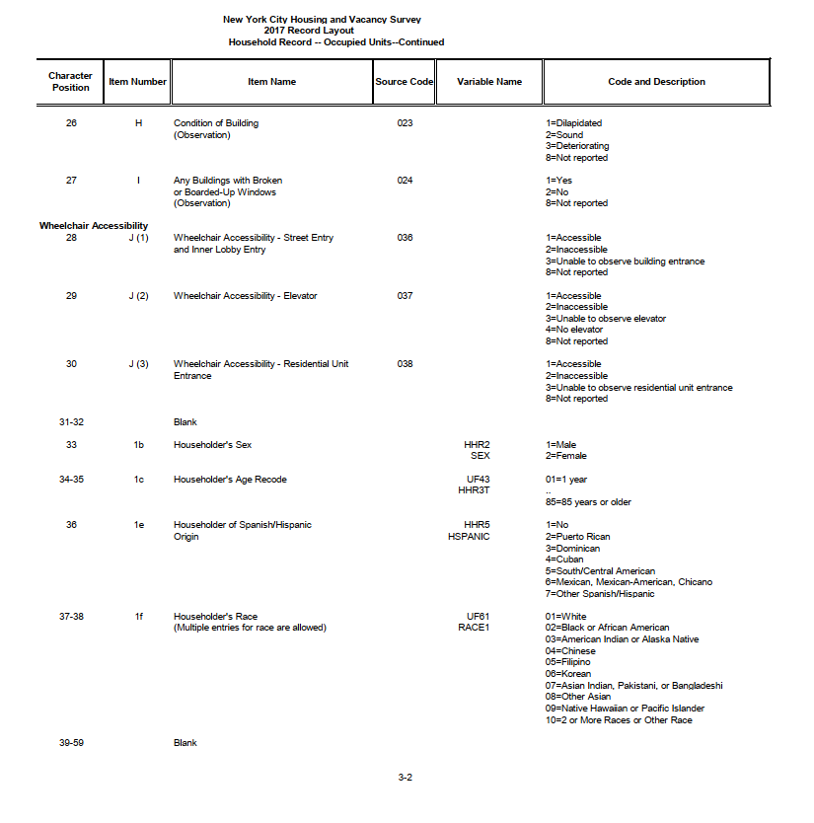
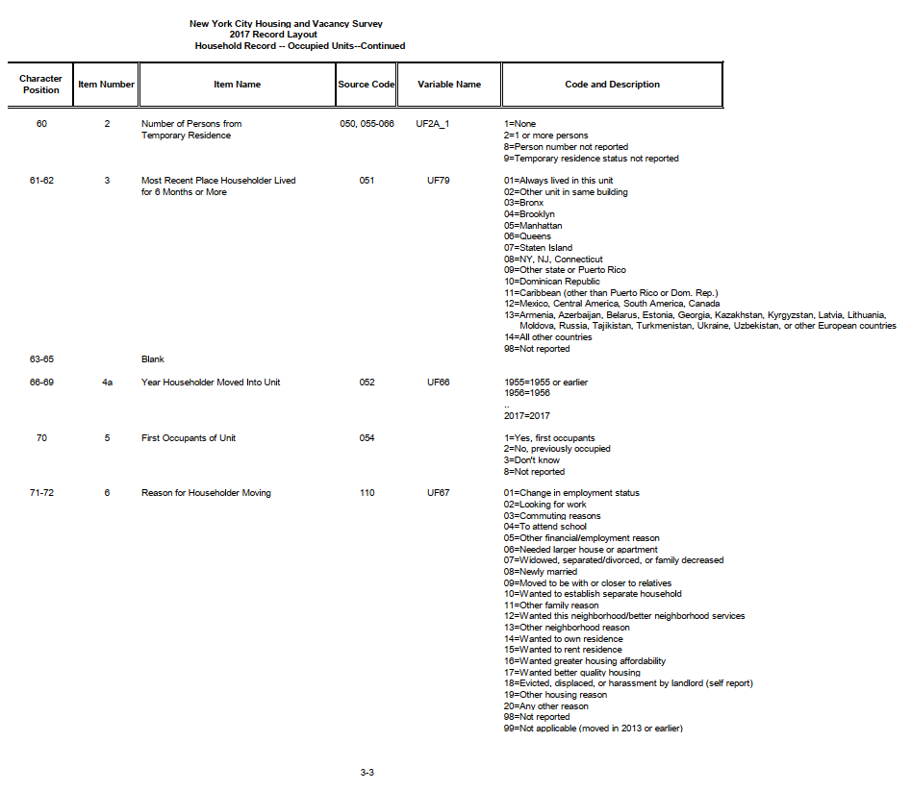
Householder’s characters

Slide 18
Variables Selection
We use a regression model to select variables which are statistically significant with PQI.
It is hard to see a direct analysis result from regression due to categorcial variable type.
Instead, we further explore the variable by visualization.

Slide 19
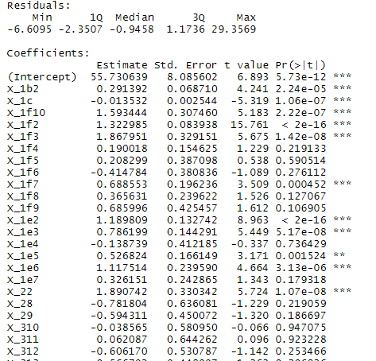
Variables Selection

Slide 20
Variables Selection
The result show the variable X_1b, X_1c, X_1f, X_1e, X_2, X_3, X_4a, X_6 are statistically significant with the PQI.
We will present some interesting results for visualizing these variables in the next slides.

Slide 21
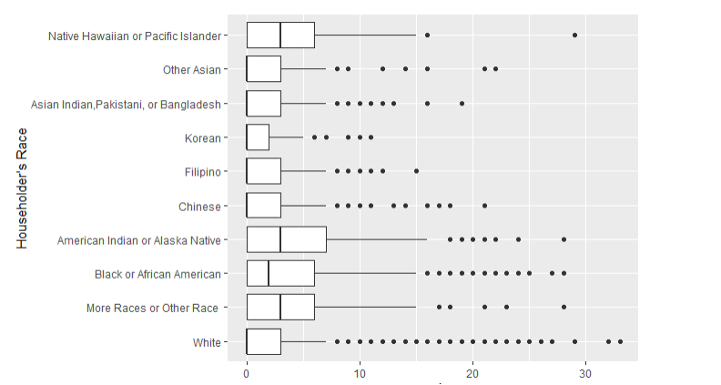
Householder's Race
The Native Hawaiian or Pacific islander, American Indian or Alaska Native, Black or African American generally live in the house which has higher PQI .
While Korean, Chinese and white live in the house with lower PQI.

Slide 22
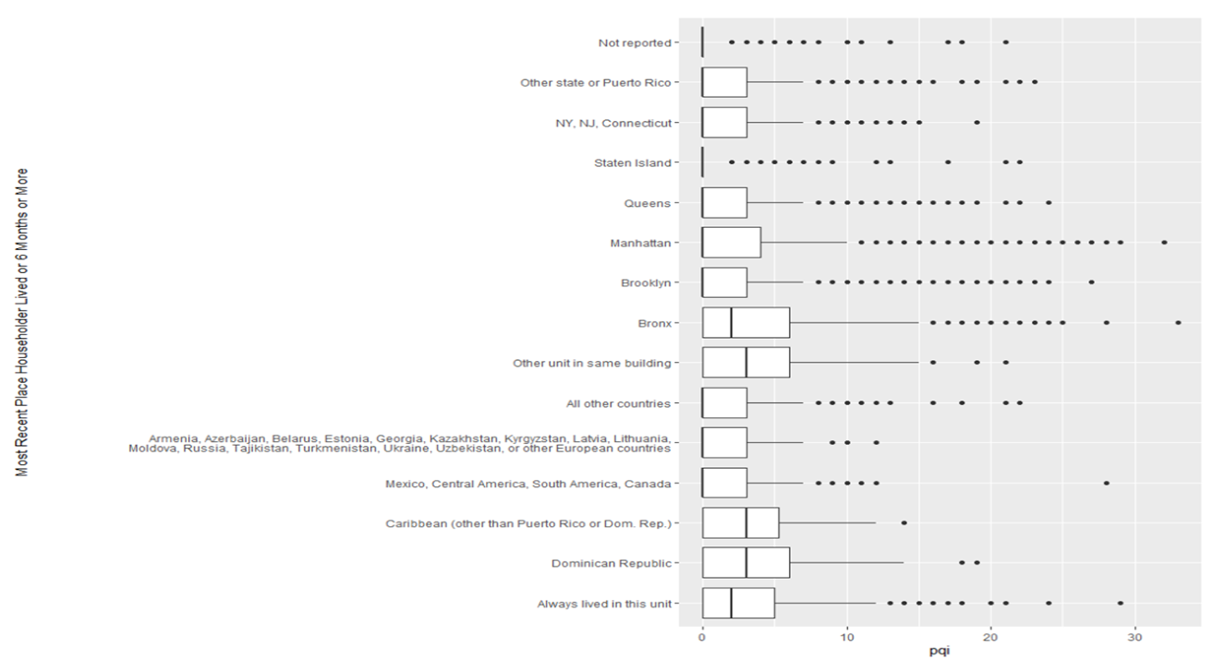
Most Recent Place Householder Lived for 6 Months or More
The householders who had lived for 6 month or more in the Bronx, Caribbean and Dominican Republic has higher PQI
Interestingly, the householders who always lived in the same unit has higher PQI.

Slide 23
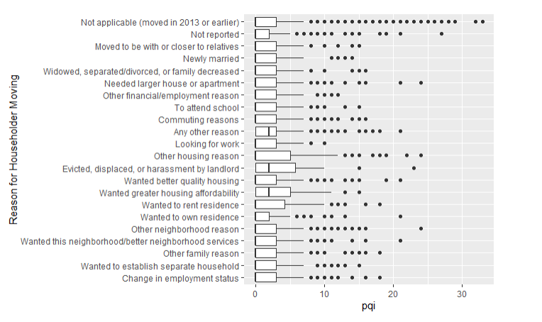
Reason for Householder Moving
The householders who moved out due to evicted,displaced,or harassment by lanlord and householders wanting greater house affordability are more likely to live in the house with high PQI.

Slide 24
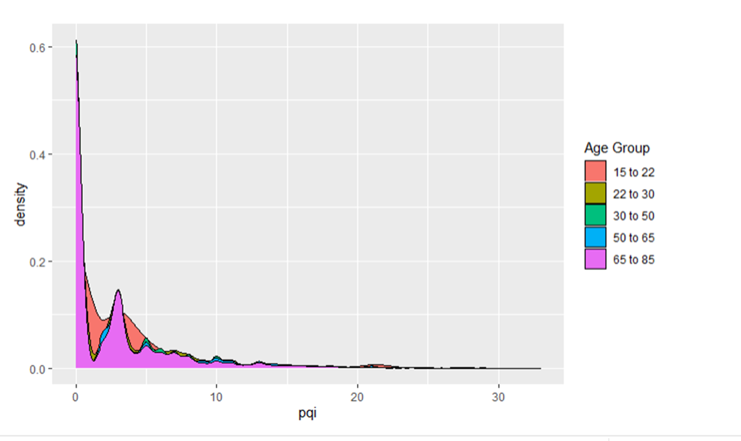
Age Group
The householders in age group 15 to 22 have a different distribution with householders in other age groups.
Near the Second peak, people in age group 15 to 22 have a more smooth curve than other age groups.
The householders in 15 to 22 are more flexible in accepting various house conditions near a PQI index 3 than other age groups.

Slide 25
Questions?
Thank you

